Slide 1


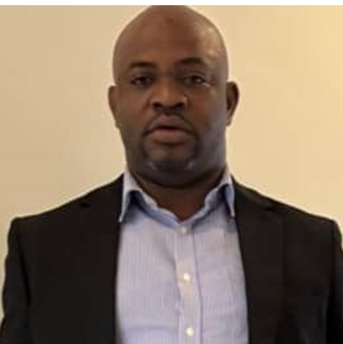
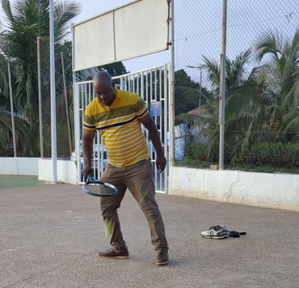
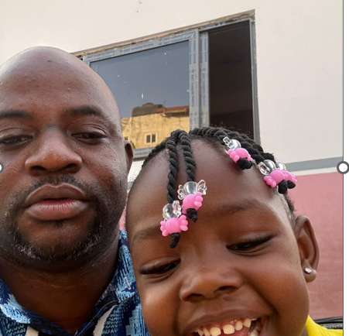
Getting to Know Me
Work
Personal
My role
Human Rights & Inclusion Officer
Significant others / family members / furry friends in my life
Janet Ampomah (My wife)
Tenure in ofi/Olam
8 months
How I enjoy spending my free time
Watching football
Previous companies I have worked at
Barry Callebaut, International Cocoa Initiative, Winrock International, Kuapa Kokoo Farmers Union
My favorite / comfort food
Banku and okro stew
Why I joined ofi/Olam and what keeps me here?
Ofi operates across multiple continents, allowing me to work with diverse personalities from various regions. This will broaden my network and enhance my professional experience with people from different cultural backgrounds."
My favorite song
I love you, Lord (By Cece Winans)
David Oppong
‘David’
A few fun facts about me;
I collect postcards from every place I travel- my fridge is basically a world map
This is me outside work, doing stuff I enjoy in my life …

